Slide 1
Feature Analysis to League of Legends Victory Prediction on the Picks and Bans Phase
Lincoln M. Costa, Rafael G. Mantovani, Francisco Carlos M. Souza, Geraldo Xexéo.
PESC/COPPE/UFRJ
costa@cos.ufrj.br
Notes:
Good morning everyone, it is a pleasure to be here today. My name is Lincoln and my here to present my research entitled Feature Analysis to League of Legends Victory Prediction on the Picks and Bans Phase. Rafael, Francisco and Geraldo also worked with me in this paper.

Slide 2
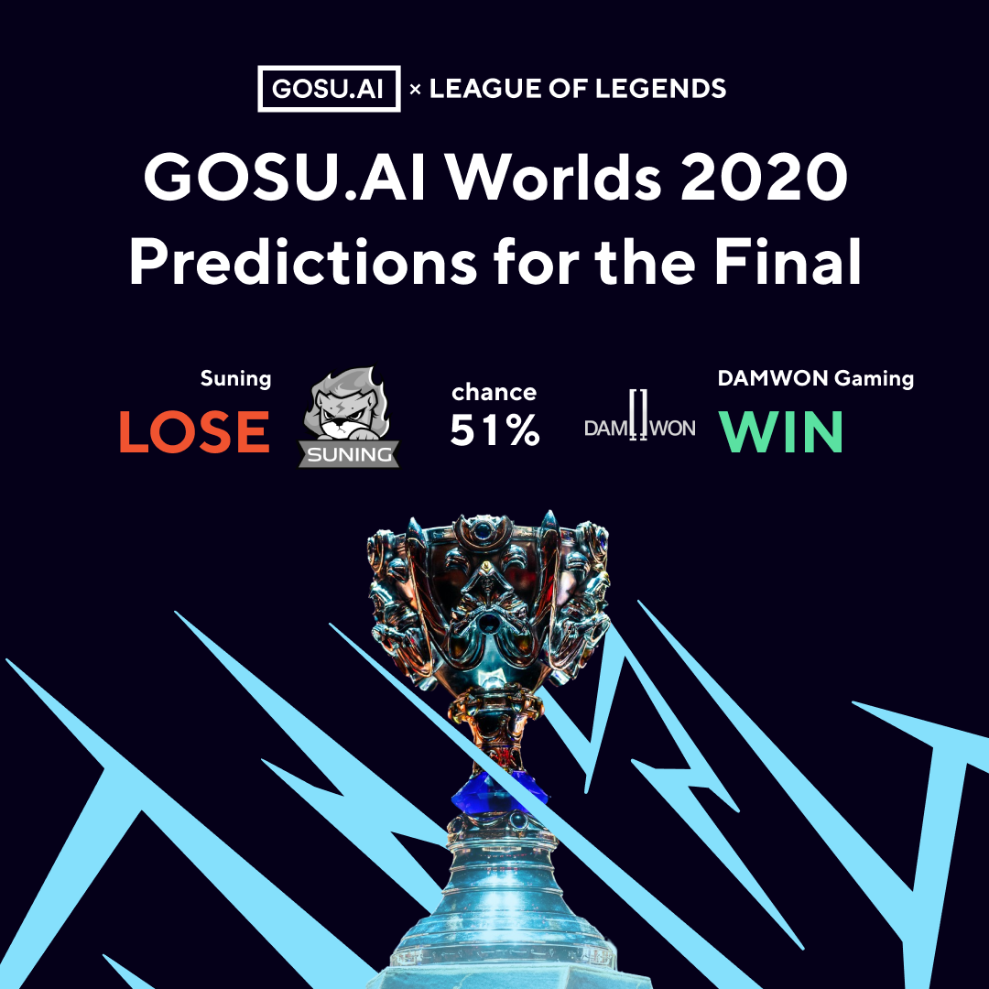
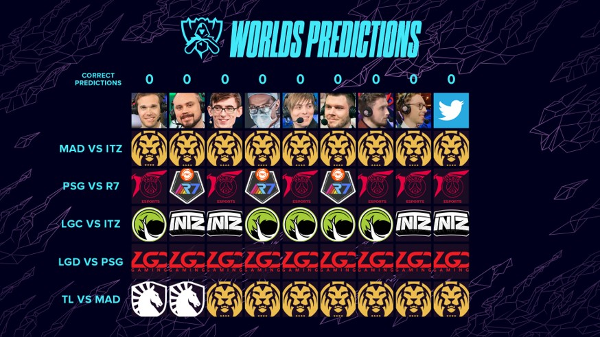
League of Legends victory prediction
Notes:
Predictions and guesses are often performed in various traditional and electronic sports. They happen between casters, fans, and even artificial intelligence models. Here we have two images representing guesses and predictions made during the 2020 League of Legends World Championship. They presents predictions made by Riot Games’ casters, LoL fans (represented by the twitter icon) and GOSU AI. Don't know League of Legends? No problem, I'll give you a brief explanation of the game.

Slide 3
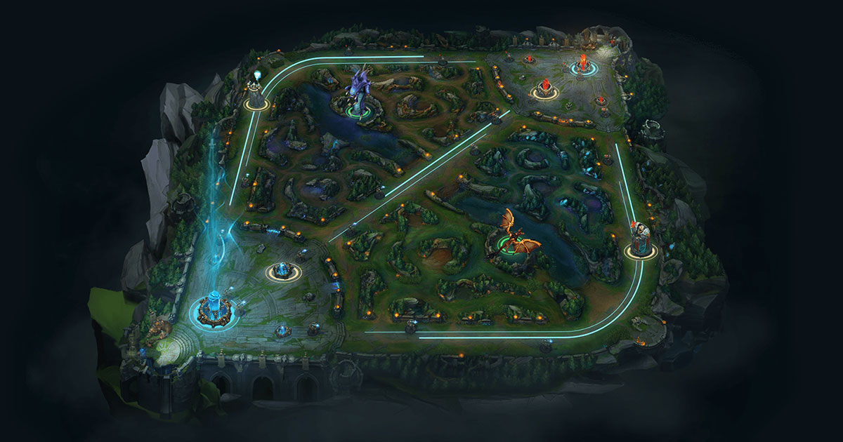
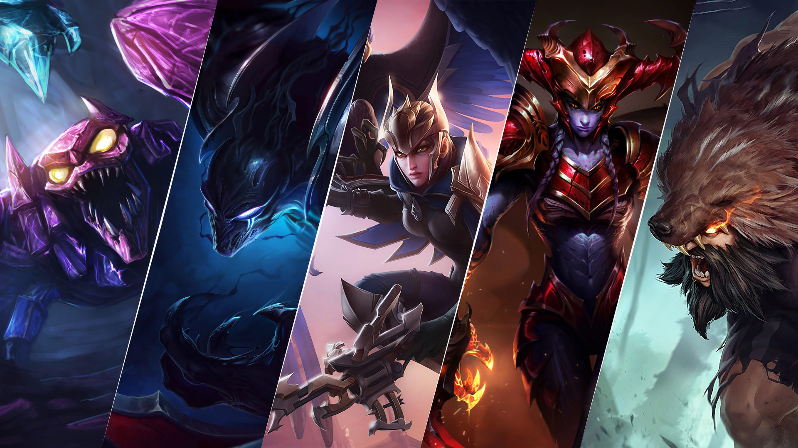
League of Legends
Notes:
League of Legends (LoL) is a MOBA game developed Riot Games. Each match has two teams (red and blue) of five players fighting across three lanes. The main objective of the game is to destroy the enemy nexus, a structure localized on the base of each team, while simultaneously defending theirs. Before the match begins, players must select a character (also known as champion) before the match begins in a step called Picks and Bans Phase.

Slide 4
Related work
According to our findings, only Ani (2019) conducted experiments using League of Legends pre-game information.
Victoria Hodge et al. (2019) focused on the audience experience while watching DOTA 2 games and aims to explain professional esports matches to the spectators as the matches progress by accurately predicting the winner throughout the game.
Using RNN, Silva, Pappa, and Chaimowicz (2018) studied the prediction of League of Legends in specifics time interval.
Kim, Lee, and Chung (2020) proposed a confidence-calibration method for predicting the winner of League of Legends matches.
Notes:
According to our findings, only Ani (2019) conducted experiments using League of Legends pre-game information. Victoria predicts the winner of a DOTA 2 match throughout the game, focusing on the explaination to the spectators. Similar to this, Silva conducted experiments in different time intervals of League of Legends matches. Unlike the previous ones, Kim proposed a confidence-calibration method for predicting the winner of League of Legends matches.

Slide 5
Methodology: datasets
Id | Dataset | Description
1 | Banned Champions | Champions banned by both teams and the match result
2 | Picked Champions | Champions selected by both teams and the match result
3 | Players Statistics | Performance history (Win Rate, KDA ratio and Game Played) of the players with the champions they selected for the game
4 | Picked Champions and Players Statistics | Merge two of the datasets with best performance (2 and 3)
5 | Complete | Merge all the three datasets aforementioned (1, 2 and 3)
Notes:
We considered three main datasets for our experiments, and from the merger of some of them we generate two others. The first dataset displays the champions banned by both teams and the outcome of the match. The second features the champions selected by both teams and the result. Dataset 3 contains the performance history of the players with the champions they selected for the game, and datasets 4 and 5 are mergers of some of the previously presented datasets. Our goal with this division was to test different combinations of features. In addition, we also conducted other experiments to reinforce the importance of each of the features.

Slide 6
Methodology: algorithms and experiment design
The following algorithms were used: Logistic Regression (LR), Decision Trees (DTs), Naive Bayes (NB), k-Nearest Neighbors (kNN), Random Forest (RF), and Support Vector Machines (SVMs).
Each algorithm was performed using a 10-fold cross-validation (CV) resampling with 5 repetitions using different seeds. In addition, the data was stratified to ensure the same distribution of classes on each partition.
AUC used as performance measure.
Notes:
We conducted a benchmark comparison process using several machine learning algorithms. We executed a 10-fold cross-validation resampling with 5 repetitions. It is worth mentioning that the datasets were stratified to ensure the same class distribution on each partition. Since we have a binary classification problem, AUC was used as the performance measure.

Slide 7
Results
Our models achieved 0.97 of AUC using Random Forest and Logistic Regression algorithms with Players Statistics Dataset.
Datasets containing details about Banned Champions and Picked Champions are not descriptive enough to provide useful information of the matches’ results.
Notes:
Our models achieved 0.97 of AUC using Random Forest and Logistic Regression algorithms with Players Statistics Dataset. However, datasets containing details about Banned Champions and Picked Champions are not descriptive enough to provide useful information of the matches’ result, with AUC close to random guesses (that is 0.5).

Slide 8
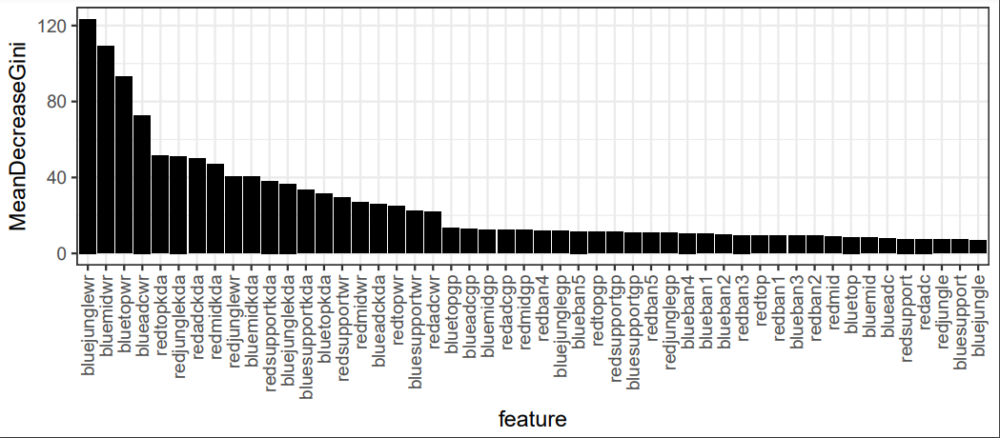
Feature importance
Notes:
The figure presents the importance of features considering the Gini Importance and the Complete Dataset. As we can see, the less relevant features are linked to champions banned and selected by both teams, while the most important features are related to the players performance history. After an empirical analysis, we believe that the high importance of features linked to the blue team may be related to the Picks & Bans order, since the blue team is the first to select. However, we have no scientific evidence on this, so we consider this to be a good future work.

Slide 9
Conclusion and future work
Predicting the results of League of Legends professional matches from Picks & Bans (draft) phase is a valuable, interesting and solvable problem.
However, more research into prediction confidence is necessary.
In our future research we intend to concentrate on using the similar features on different games like DOTA 2.
Notes:
Speaking of future work, we believe that predicting results in Professional League of Legends matches in the Picks & Bans phase is a valuable, interesting and solvable problem. We also believe that, as mentioned by Kim, greater attention is needed on the reliability of predictions in order to avoid uncertain predictions. In the future we intend to perform similar experiments in professional matches of other games such as DOTA 2.

Slide 10

Thank you!
Lincoln M. Costa , Rafael G. Mantovani, Francisco Carlos M. Souza, Geraldo Xexéo.
PESC/COPPE/UFRJ
costa@cos.ufrj.br
Notes:
Thanks for the attention!

